Slide 1
6 Degrees of Information

Slide 2
Social Media in your lives Today
https://whatsthebigdata.com/how-many-teens-use-social-media/

Slide 3
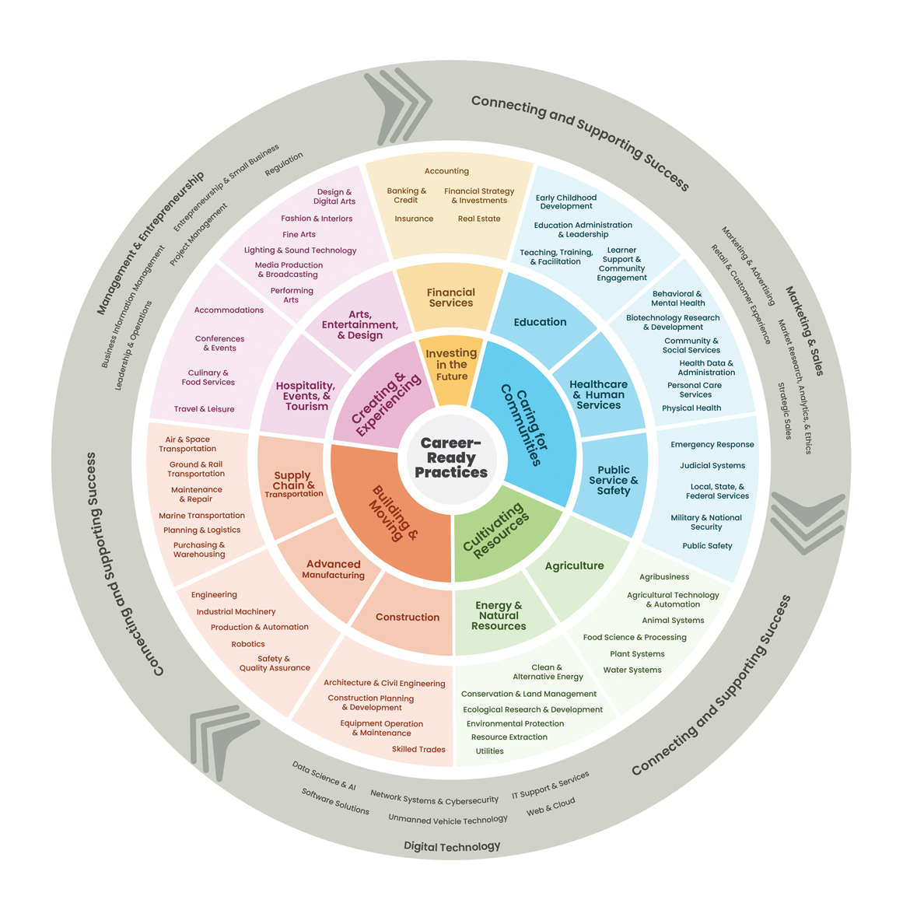
Do you know that things you share on social media today can affect your future negatively tomorrow?
What does TMI stands for?
Too Much Information
Have you ever seen someone post something online that you consider to be TMI?
What do YOU share on Social Media?

Slide 21
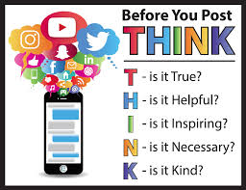

Slide 22
Resources
Source: Adapted from "Who R U" interest survey with permission from Virginia Career View.
Career Wonders 2011, SD Dept. of Labor and Regulation.
https://whatsthebigdata.com/how-many-teens-use-social-media/
https://careertech.org/career-clusters/
https://ycal.us/students/10careerquestions/
https://www.missingkids.org/netsmartz/home

